Slide 1
Reminder: Analog and Digital signals
Analog signal: a continuous signal of varying quantity which normally has a time varying feature
Digital signal: signal represented as discrete values and can only take one of a finite number of values.

Slide 2
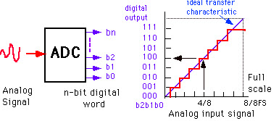
Review: ADCs (digital conversion)
Bit resolution
How much accuracy can the ADC convert from analog to digital?
3-bit ADC can provide 2³ divisions (8) in signal
8-bit ADC = 256 division
16-bit ADC = 65536

Slide 3
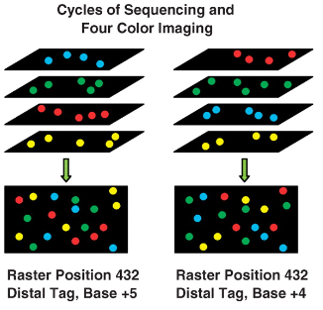
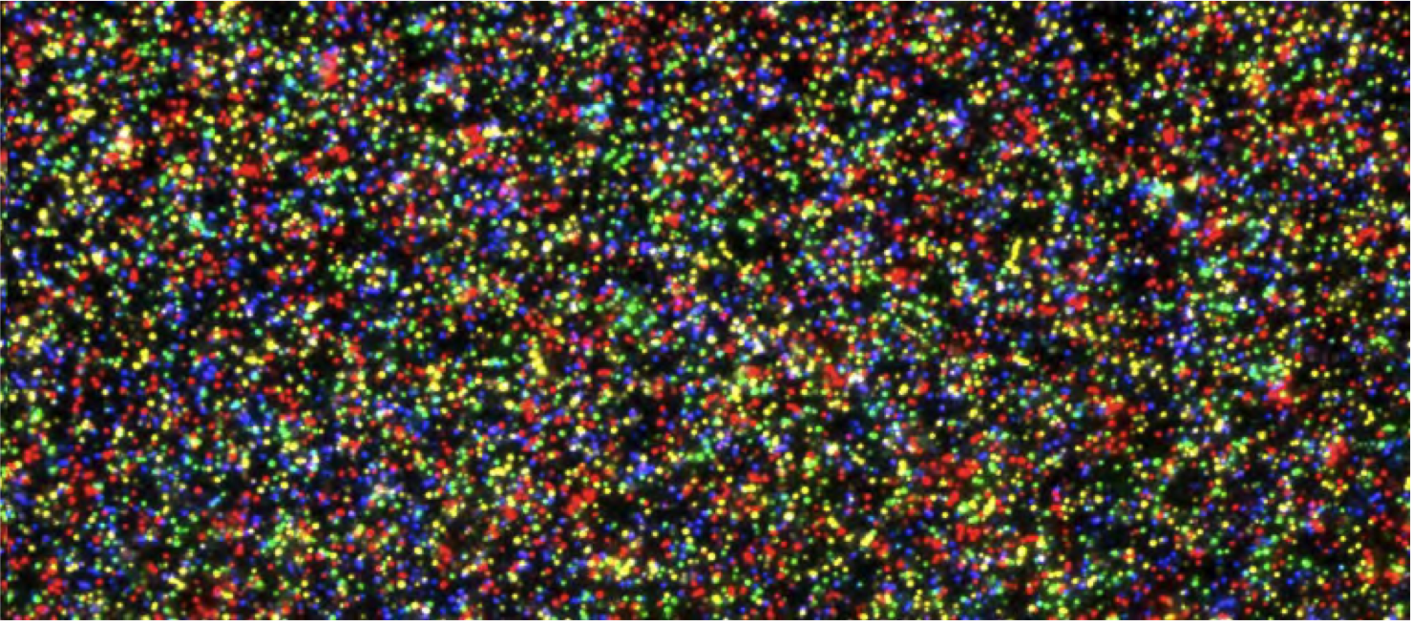
Other types of analog to digital conversion in Omics?
= X reads
3-bit ADC can provide 2³ divisions (8) in signal
8-bit ADC = 256 division
16-bit ADC = 65,536
24-bit ADC = 16,777,216
32-bit ADC = 4,294,967,296

Slide 4
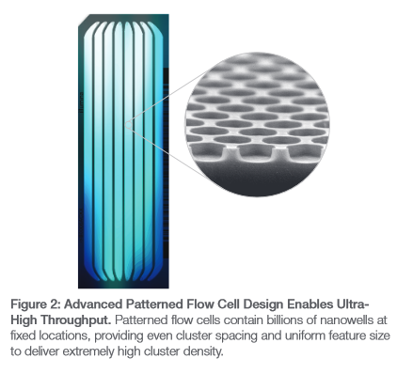
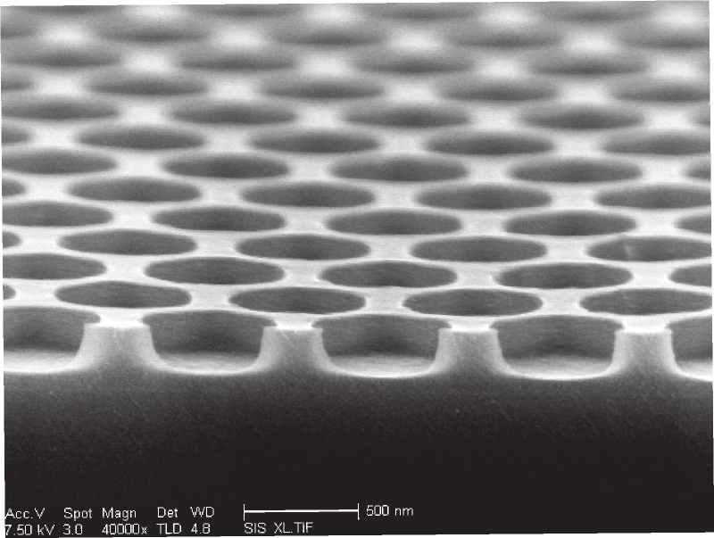
In practice: Today … wells are at fixed locations
Each well is basically 1-bit that takes 4 measurements to measure one base

Slide 5
Quantitative Bit Resolution for RNA-Seq = Reads
Scenario:
40 million reads
~10,000 unique molecular species
Mean mRNA molecule copy per cell = 5
Dynamic range of mRNA molecules per cell 1-100
Questions:
Is 40 million reads enough?
If yes, why?
If no, what would be a good number?
Notes:
40,000,000 reads / 10,000 molecular species = ~4000 reads on average per molecular species
400,000 mRNA molecules per cell … so ~100 reads for mRNA at the single copy level.

Slide 6
Quantitative Bit Resolution for RNA-Seq = Reads
Scenario:
40 million reads
~10,000 unique molecular species
Mean mRNA molecule copy per cell = 50,000
Dynamic range mRNA molecules per cell 10 to 1 million
Questions:
Is 40 million reads enough?
If yes, why?
If no, what would be a good number?
Notes:
40,000,000 reads / 10,000 molecular species = ~4000 reads on average per molecular species
4,000,000,000 molecules … 0.01 read for molecule.

Slide 7
Selectivity vs Sensitivity

Slide 8
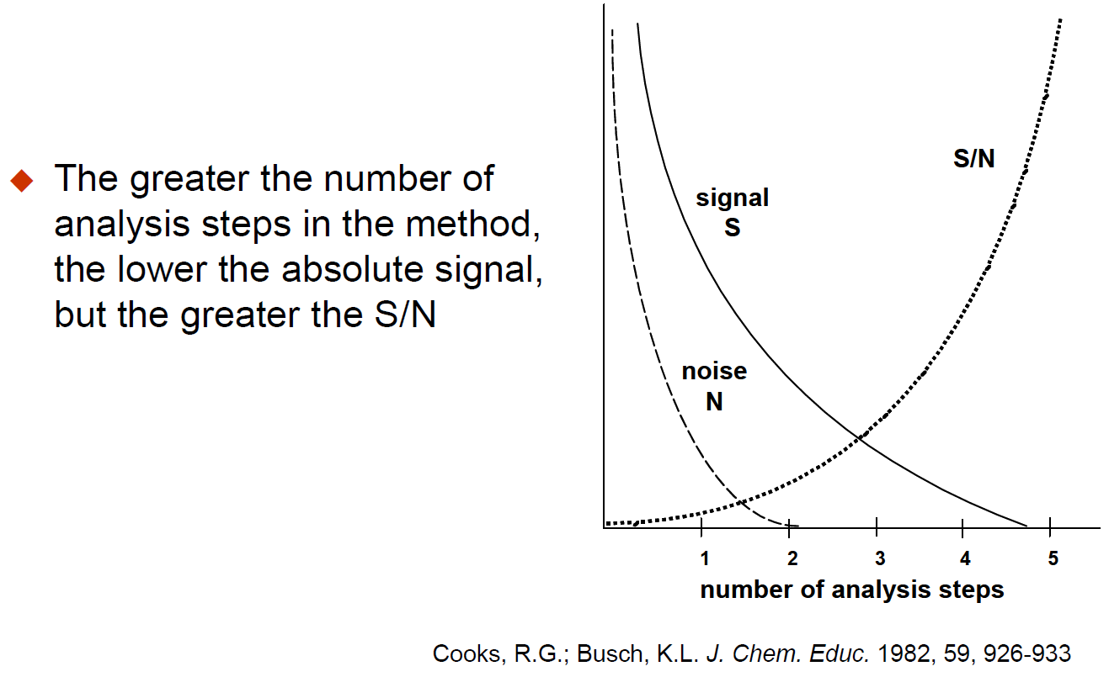

Slide 9
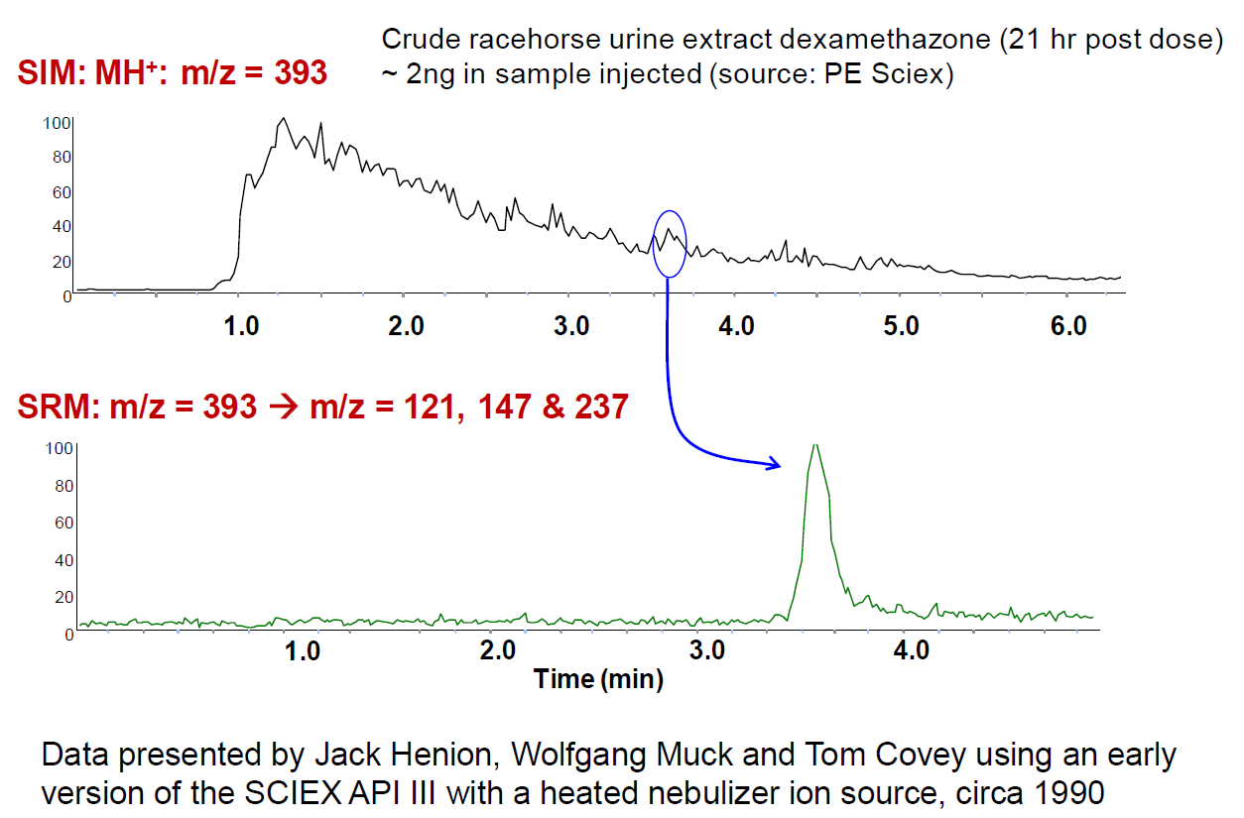

Slide 10
Fluorescence Advantage
Fluorescence is measured over a dark background, while absorbance is measured over a bright background.
Measuring signal over a large background is hard.
Chemical noise/background is a major limitation.

Slide 11
Quantitative Analysis 101
What does it mean to be quantitative?

Slide 12
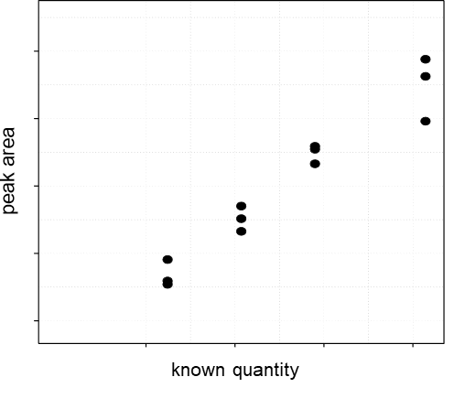
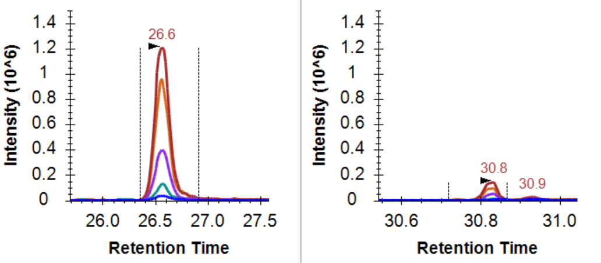
The change in signal should reflect the change in quantity

Slide 13
Quantitative Analysis 101
ULOQ
Linear Dynamic Range
Measured Intensity (Area)
LOD
LLOQ
Amount (moles)
LOD: Limit of Detection
LLOQ: Lower Limit of Quantitation
ULOQ: Upper Limit of Quantitation

Slide 14
Quantitative Analysis 101: Using an Internal Std
ULOQ
Linear Dynamic Range
Intensity Ratio (Area Ratio)
LOD
LLOQ
Amount (moles)
LOD: Limit of Detection
LLOQ: Lower Limit of Quantitation
ULOQ: Upper Limit of Quantitation

Slide 15
Quantitative Analysis 101
What does it mean to be quantitative?
What does signal calibration mean?

Slide 16
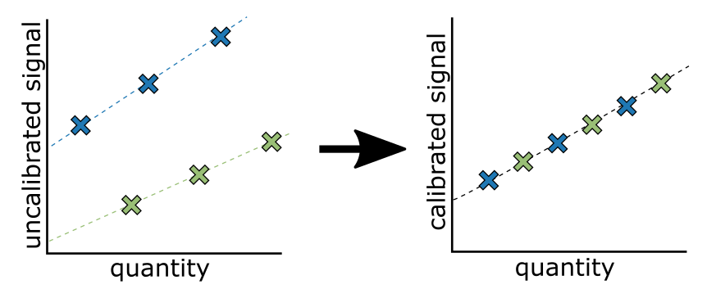
Measurements on different platforms are not measured on the same scale

Slide 17
Between Batch/Platform/Lab Signal Calibration
Purpose of signal calibration
Placing signal on the same scale
Often the scale is arbitrary
Kilogram = mass of a liter of water at freezing point
Meter = 1/10,000,000 the distance from the equator to the north pole
Pee dee belomnite (PDB) = reference for 13C, fossil found in Peedee Formation in South Carolina
Standard mean ocean water (SMOW) = reference for 18O, arbitrary mix of distilled water from different regions of the world.

Slide 18
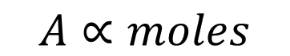
Use of calibration curve to convert signal to quantity
Analyte (m/z = M)
$$A∝moles$$
M
A
Intensity
Intensity
m/z
time
Measured Signal (Area)
Known Amount
Where: k_{i}= is the slope of the standard curve A_{b} ≈ 0 Area from a blank

Slide 19
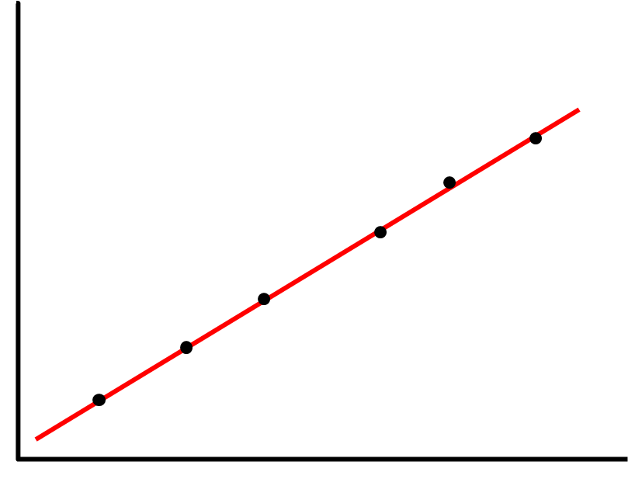
Use of calibration curve to convert signal to quantity
Sample (m/z = M) Spiked with
Internal Standard (m/z = M+i)
A₀
A_{i}
n₀
n_{i}
M+ i
R₀ =
∝
Intensity
Intensity
M
m/z
time
Measured Signal (Area Ratio)
Known Amount
Where: k_{0/i}= is the slope of the standard curve R_{i} ≈ 0 Area ratio from a blank … only internal std

Slide 20
What you calibrate against is important

Slide 21
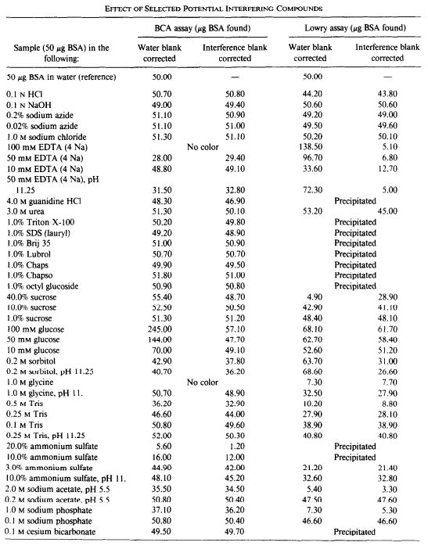
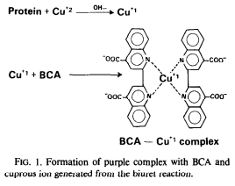
What you calibrate against is important
Bicinchoninic acid (BCA) is the current standard for measuring protein abundance.

Slide 22
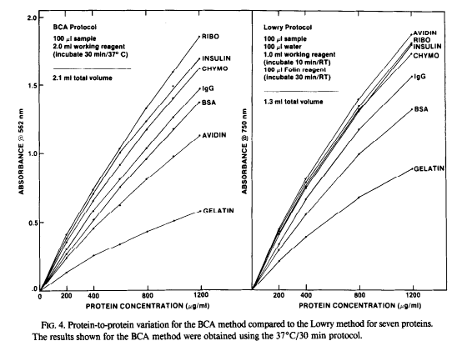
What you calibrate against is important
Smith et al., Anal Biochem 1985

Slide 23
What is the difference between relative and absolute quantitation?

Slide 24
What is the difference between a “differential” and a “quantitative” measurement?

Slide 25
What does it mean if these are the two points?
ULOQ
Linear Dynamic Range
Measured Intensity (Area)
LOD
LLOQ
Amount (moles)
LOD: Limit of Detection
LLOQ: Lower Limit of Quantitation
ULOQ: Upper Limit of Quantitation

Slide 26
Major Quantitative Figures of Merit
LOD – Limit of Detection
LLOQ – Limit of Quantitation
Precision
Within batch/day
Between batch/day

Slide 27
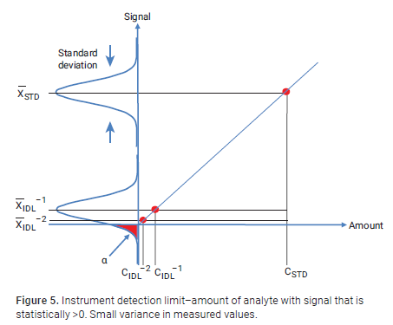
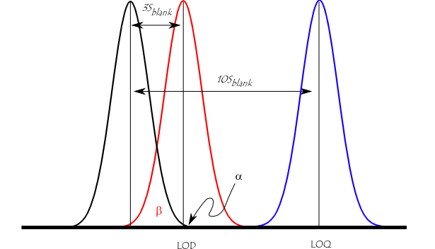
Limit of detection
Is a signal statistically different from a blank?

Slide 28

Limit of Quantitation
Does the change in quantity reflect the change in signal?
The limit of quantitation (LOQ; also referred to as the lower limit of the measuring interval (LLMI)) is defined by the Clinical and Laboratory Standards Institute as ″the lowest measurand concentration at which all defined performance characteristics of the measurement procedure are met.″
Our lab often chooses for LLOQ:
Must be >LOD
Must have a coefficient of variation <20% (aka S/N >5)

Slide 29
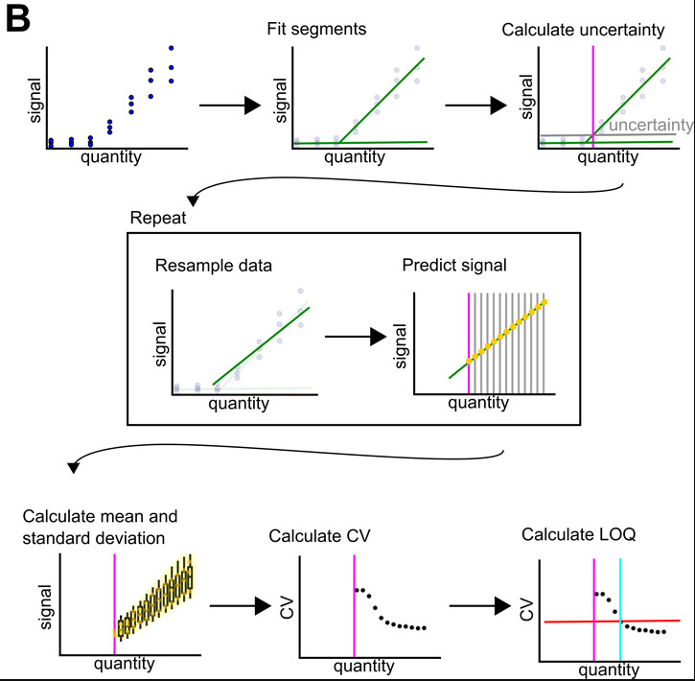
Limit of Quantitation
Does the change in quantity reflect the change in signal?
The limit of quantitation (LOQ; also referred to as the lower limit of the measuring interval (LLMI)) is defined by the Clinical and Laboratory Standards Institute as ″the lowest measurand concentration at which all defined performance characteristics of the measurement procedure are met.″

Slide 30
Questions:
Can a method be quantitative if you don’t know the range over which the signal reflects the quantity?
Design an approach to confirm linearity and LLOQ for peptides in a complex matrix?
Assume you have < 50 analytes in your assay.
Assume you have >1000 analytes in your assay?

Slide 31
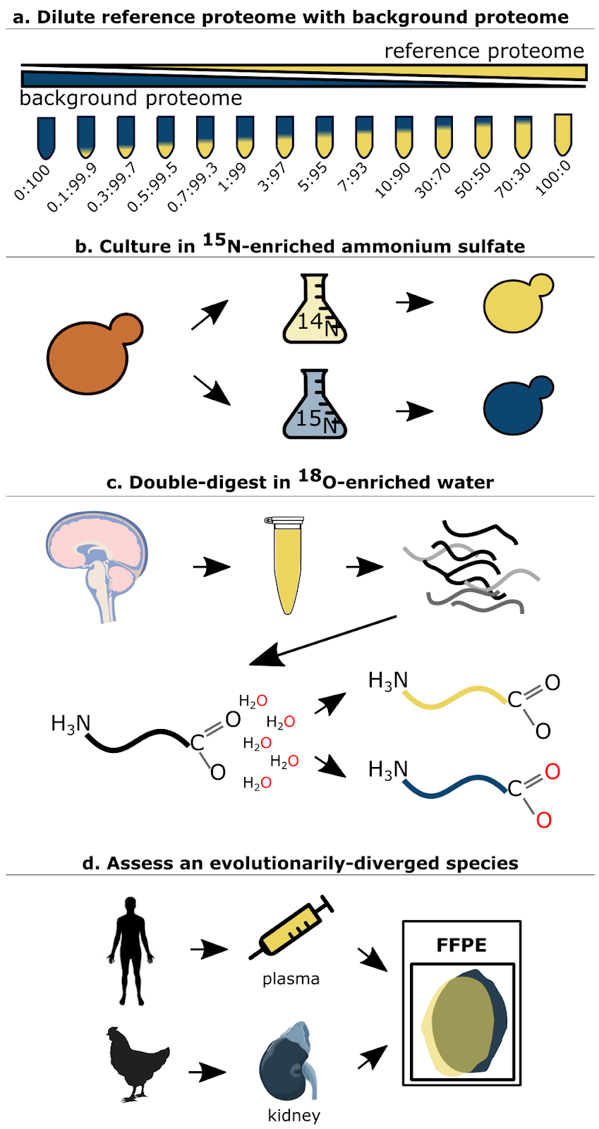
Matched Matrix Dilution Curves
Building on: Grant and Hoofnagle, Clin Chem 2014

Slide 32
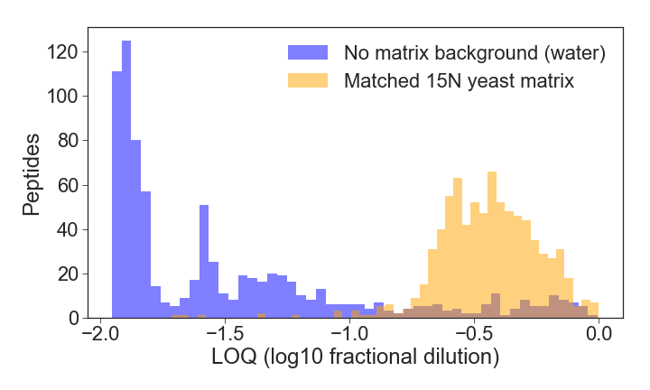
Matching the Matrix is Important

Slide 33
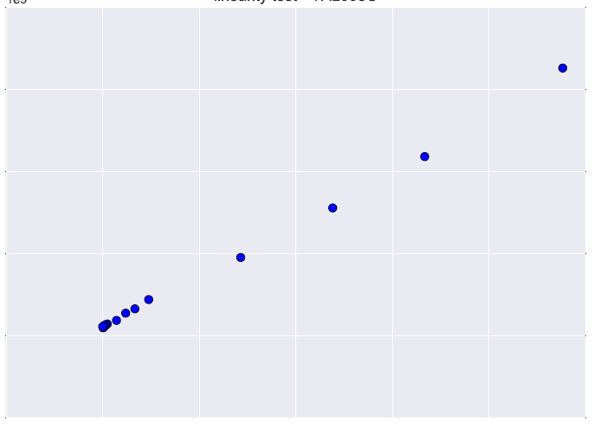
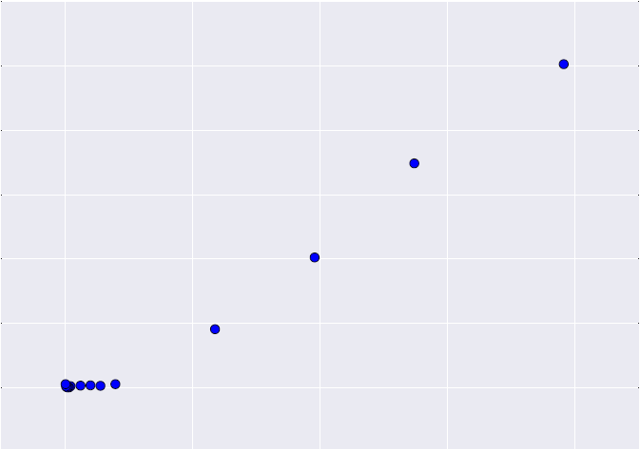
Reference Yeast BY4742 Diluted in 15N Yeast (S288c)
Protein SSA1 (2.69E+05 copies/cell)
Protein LSM2 (2.21E+03 copies/cell)
2
1.2
1.5
1.0
0.8
1
0.6
Peak area (1e9)
Peak area (1e7)
0.5
0.4
0.2
0
0
0
0.2
0.4
0.6
0.8
1
0
0.2
0.4
0.6
0.8
Fractional Dilution
Fractional Dilution
Notes:
Protein value = sum(peptides(sum(fragments))
function broken in post-3.4.0 MSstats builds, waiting to hear back from collaborator

Slide 34
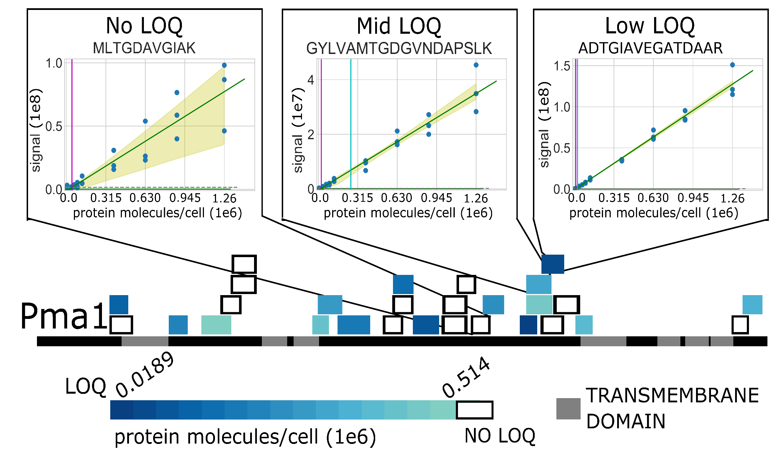
Not all Peptides are Equal Quantitative Proxies for a Protein
Notes:
plasma membrane ATPase (PMA1

Slide 35
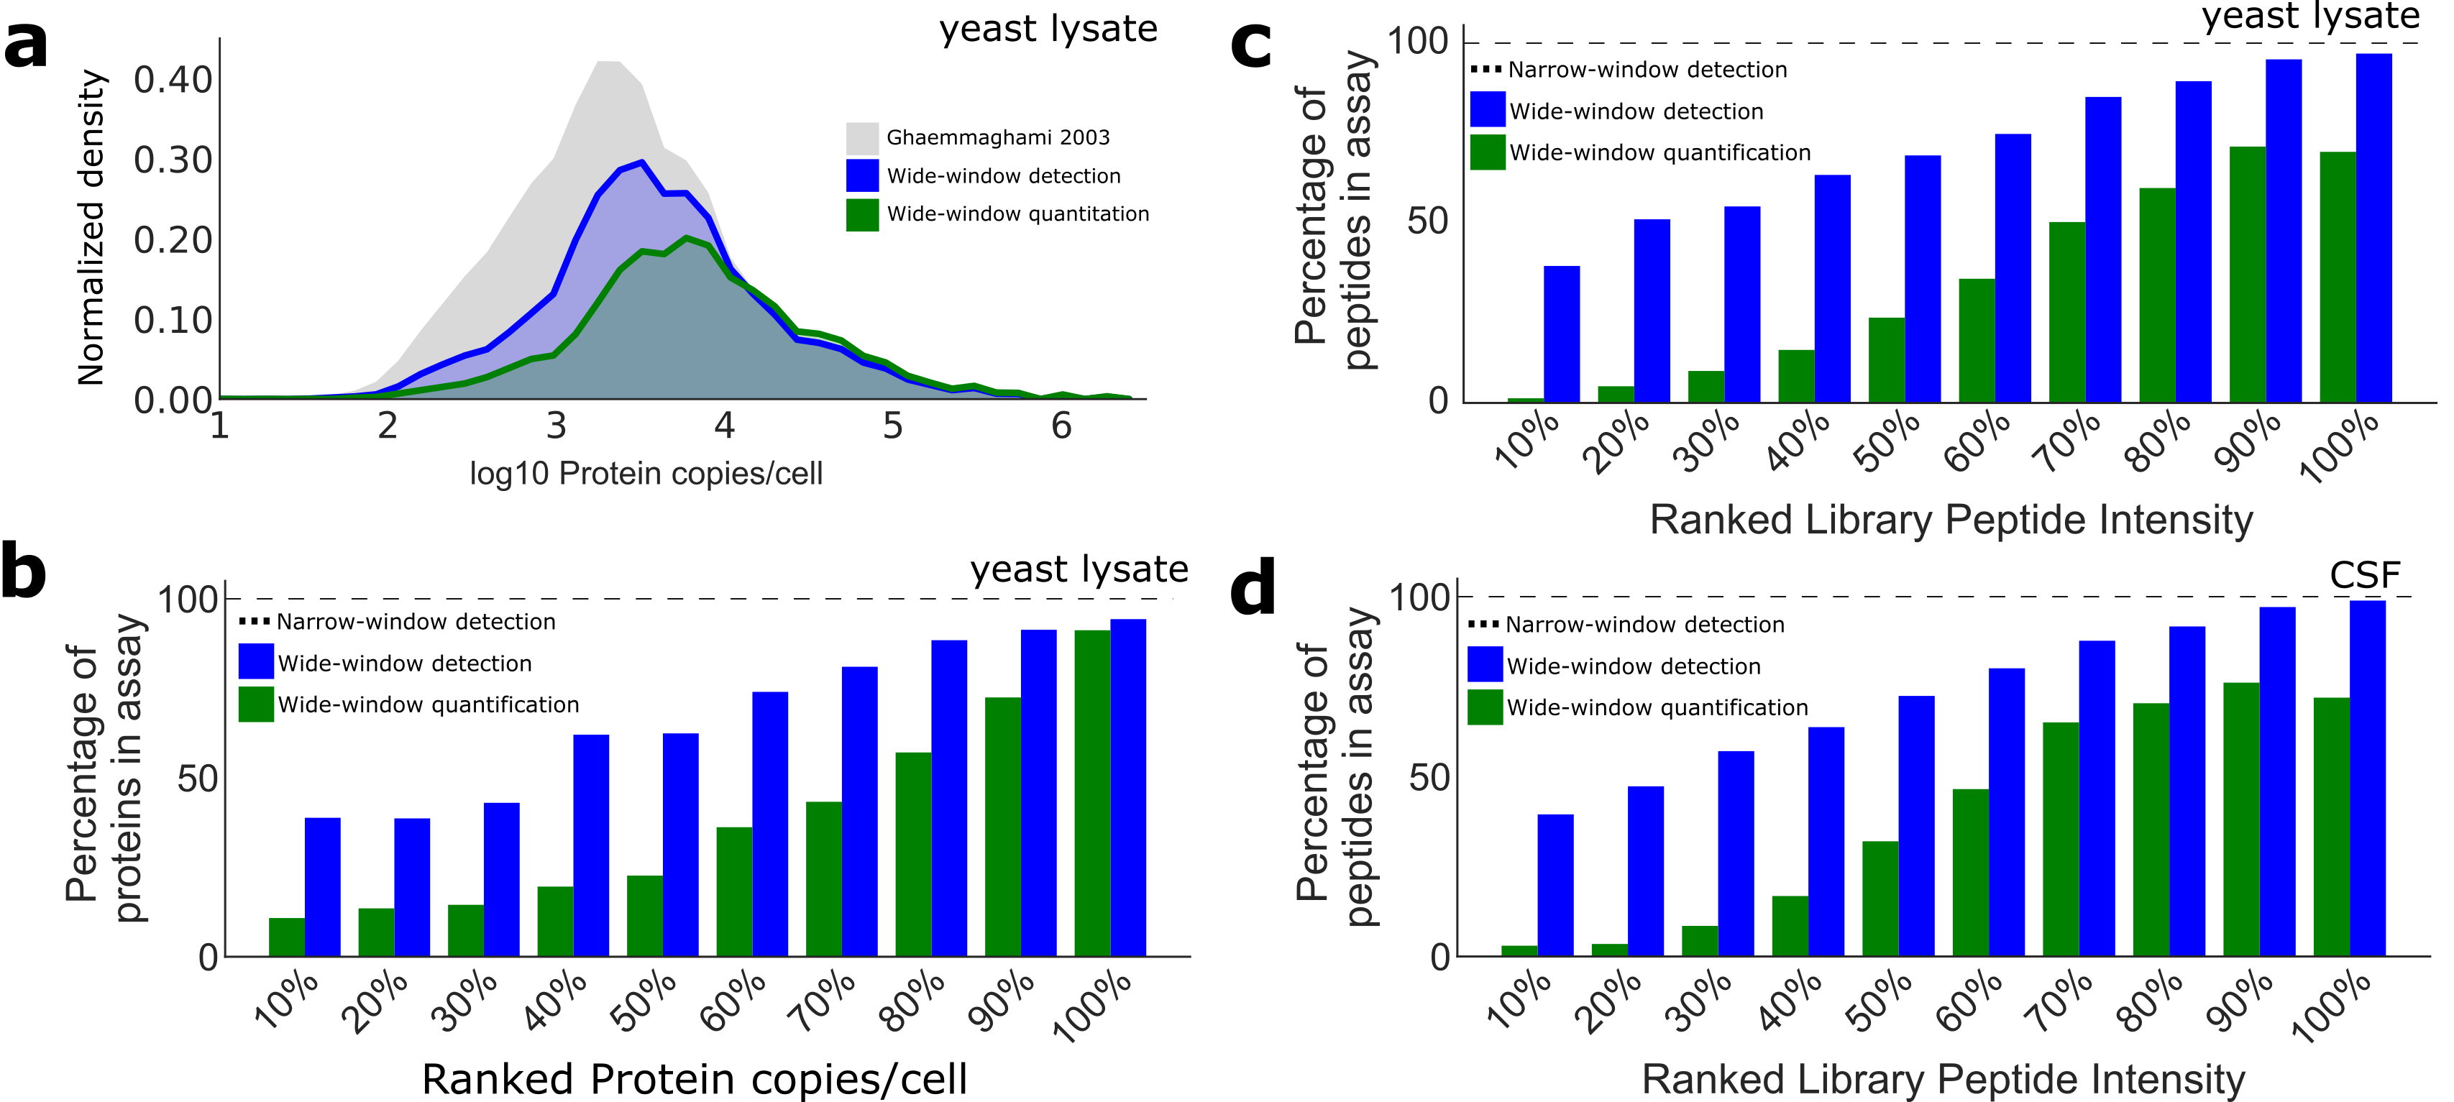
Not all Peptides are Quantitative

Slide 36
Method of Standard Addition
Can’t assess Limit of Quantification. Can only assess whether the sample us above the LOQ

Slide 37
Mixing two samples of extreme conditions
Assume that you have a healthy and a disease cohort.
You can take a pool of the healthy and a pool of the disease to demonstrate that the measurement is linear between the two conditions
Example
100% condition A
80% condition A, 20% condition B
50% condition A, 50% condition B
20% condition A, 80% condition B
100% condition B

